Slide 1

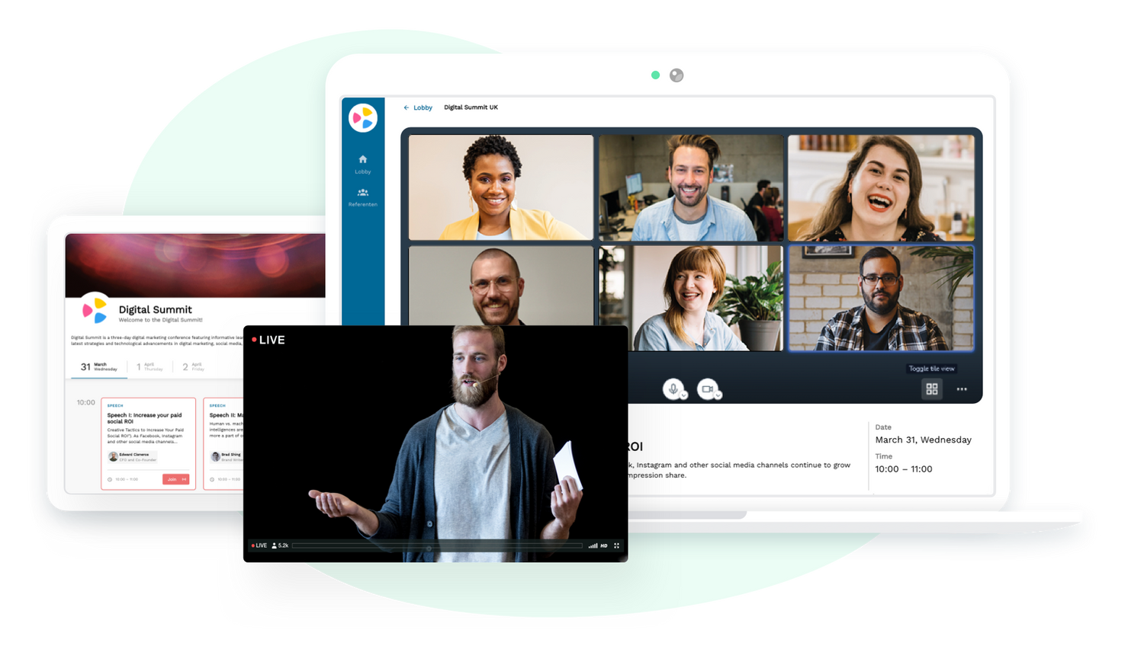

EVENTOPIA
Where Every Moment Becomes an Experience
Group 10: Linked Elites

Slide 2






Our Team
Varmi
Saumyaraj
Priyanka
Arati
Shubham
Ashika

Slide 3


Building a seamless future for events:
The eventopia mission
At Eventopia, we're dedicated to making events awesome for everyone. We give organizers easy-to-use tools to plan amazing events, while making it simple for attendees to find, join, and enjoy a variety of inspiring events. Using innovative technologies like AI and VR, we create a seamless and immersive platform where organizers can manage events effortlessly, and attendees can connect with others and have a great time.

Slide 4
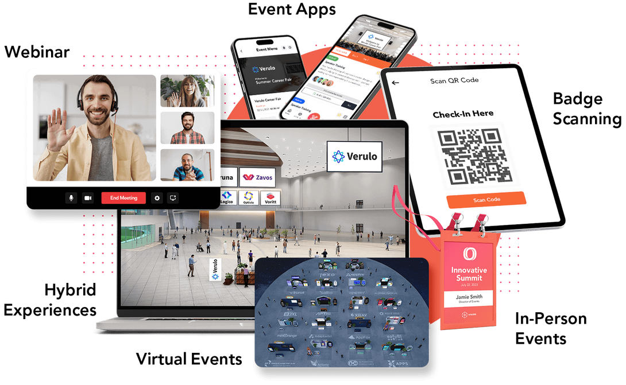
Beyond borders, beyond limits:
The eventopia vision
We envision a future where events are vibrant, inclusive, and memorable experiences that bring together organizers and attendees from around the globe. We strive to create a dynamic platform that fosters creativity, connection, and engagement for all participants, whether they are planning, hosting, or attending events.

Slide 5
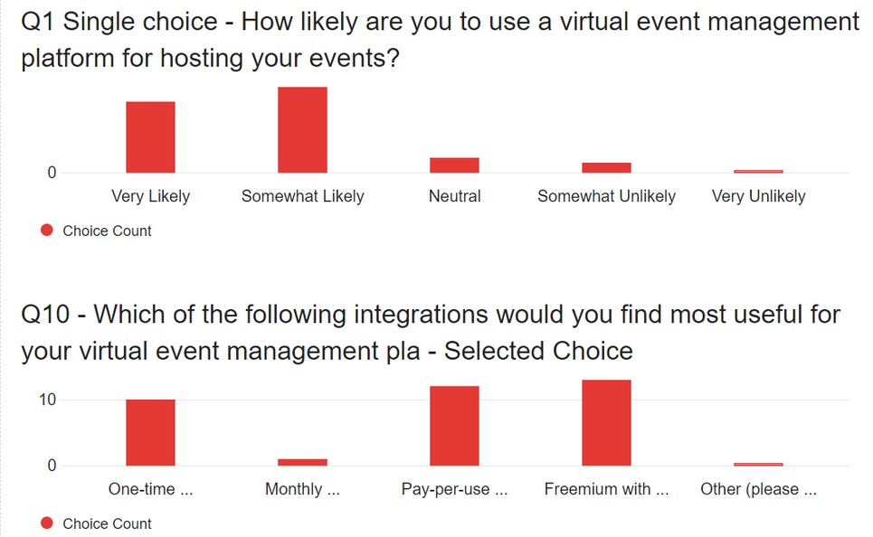
Survey Insights
89% of the users surveyed expressed interest in the event management platform.
The most preferred subscription model among respondents is Freemium with optional premium features, with 35% of respondents selecting this option.
Pay-per-use based on event size is also popular, with 32% of respondents favoring this model.
One-time payment per event and monthly subscription models are less preferred, with 27% and 5% of respondents selecting them, respectively.

Slide 6
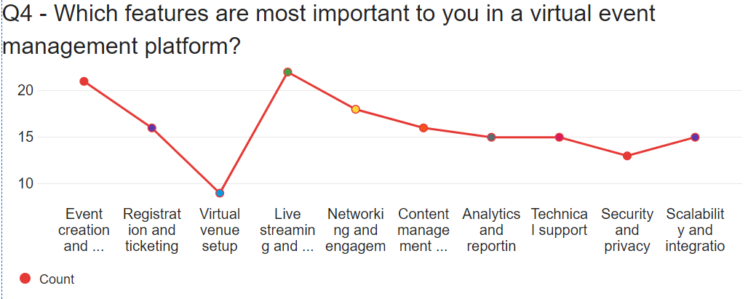
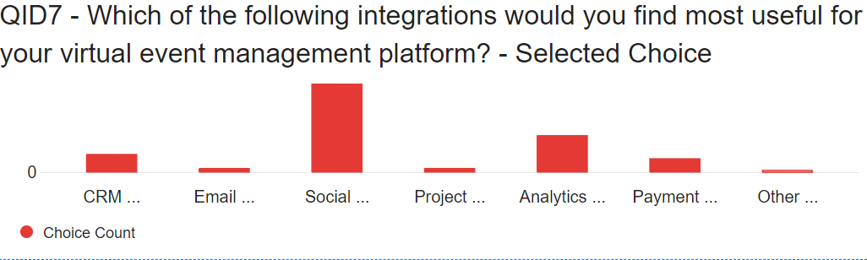
Survey Insights
Respondents prioritize features related to facilitating interactive and customizable events, seamless video conferencing and streaming capabilities, robust networking tools, and comprehensive support and analytics functionalities.
Social media integration leads with 52.78% prioritization, indicating its high value. Analytics tools closely follow at 22.22%, emphasizing event performance tracking. Payment gateways, with 8.33% interest, indicate moderate demand for seamless transactions within the platform.

Slide 7

Product Roadmap
Q1
Q2
Q3
Q4
Core Event Management with AI/ML Integration
ORGANIZERS
Feature Implementation:
Event Planning & Scheduling
Create Event (virtual, hybrid, in-person)
Event Optimization through AI: Offers intelligent suggestions for event planning
ATTENDEES
Basic AI Recommendation:
Personalized event recommendations
Blockchain, Marketing and Networking
BASE FEATURES
Website Development
Blockchain based Ticketing & Transactions
Infrastructure Support
ORGANIZERS
Event marketing
Budgeting and Expense Tracking
Analytics and reporting tools
ATTENDEES
Social & Networking Recommendations using AI
Virtual Networking Features – virtual lounges
Attendee and Event Management and AR Experience
BASE FEATURES
Mobile App Development
AR integration
AI powered Chatbot
ORGANIZERS
AI Task Automation: Automating repetitive tasks (with the help of AI)
Online check-in feature
Attendee management tool: Manage attendee data , track attendance & participation
ATTENDEES
Feedback Gathering Mechanism
Blockchain Security
Gamification tools
Product Launch
Oct 2025

Slide 8
Product Roadmap
Q5
Q6
Q7
Q8
Aftermarket Features Development
BASE FEATURES
Social Media Integration
Live Translation & Transcription
ORGANIZERS
Gamification to boost engagement
Advanced AI insights
ATTENDEES
Community Forum Establishment
Aftermarket Feature Launch
ORGANIZERS
Adjacent Market
Partnership initiatives for accommodation & event venues with hotel
AI venue suggestion
Sustainable event planning
ATTENDEES
Premium attendee member
Priority based engagement through premium features
On-demand access to recorded sessions
Aftermarket Feature Launch
BASE FEATURES
Global expansion
Introducing other global languages on website and application to reach global audiences
Facial Recognition and Biometric Authentication
ORGANIZERS
Adjacent market:
Partnership initiatives with Transportation services (Airlines)
VR Experience Feature Launch
VR Integration
Introducing Metaverse experience

Slide 9
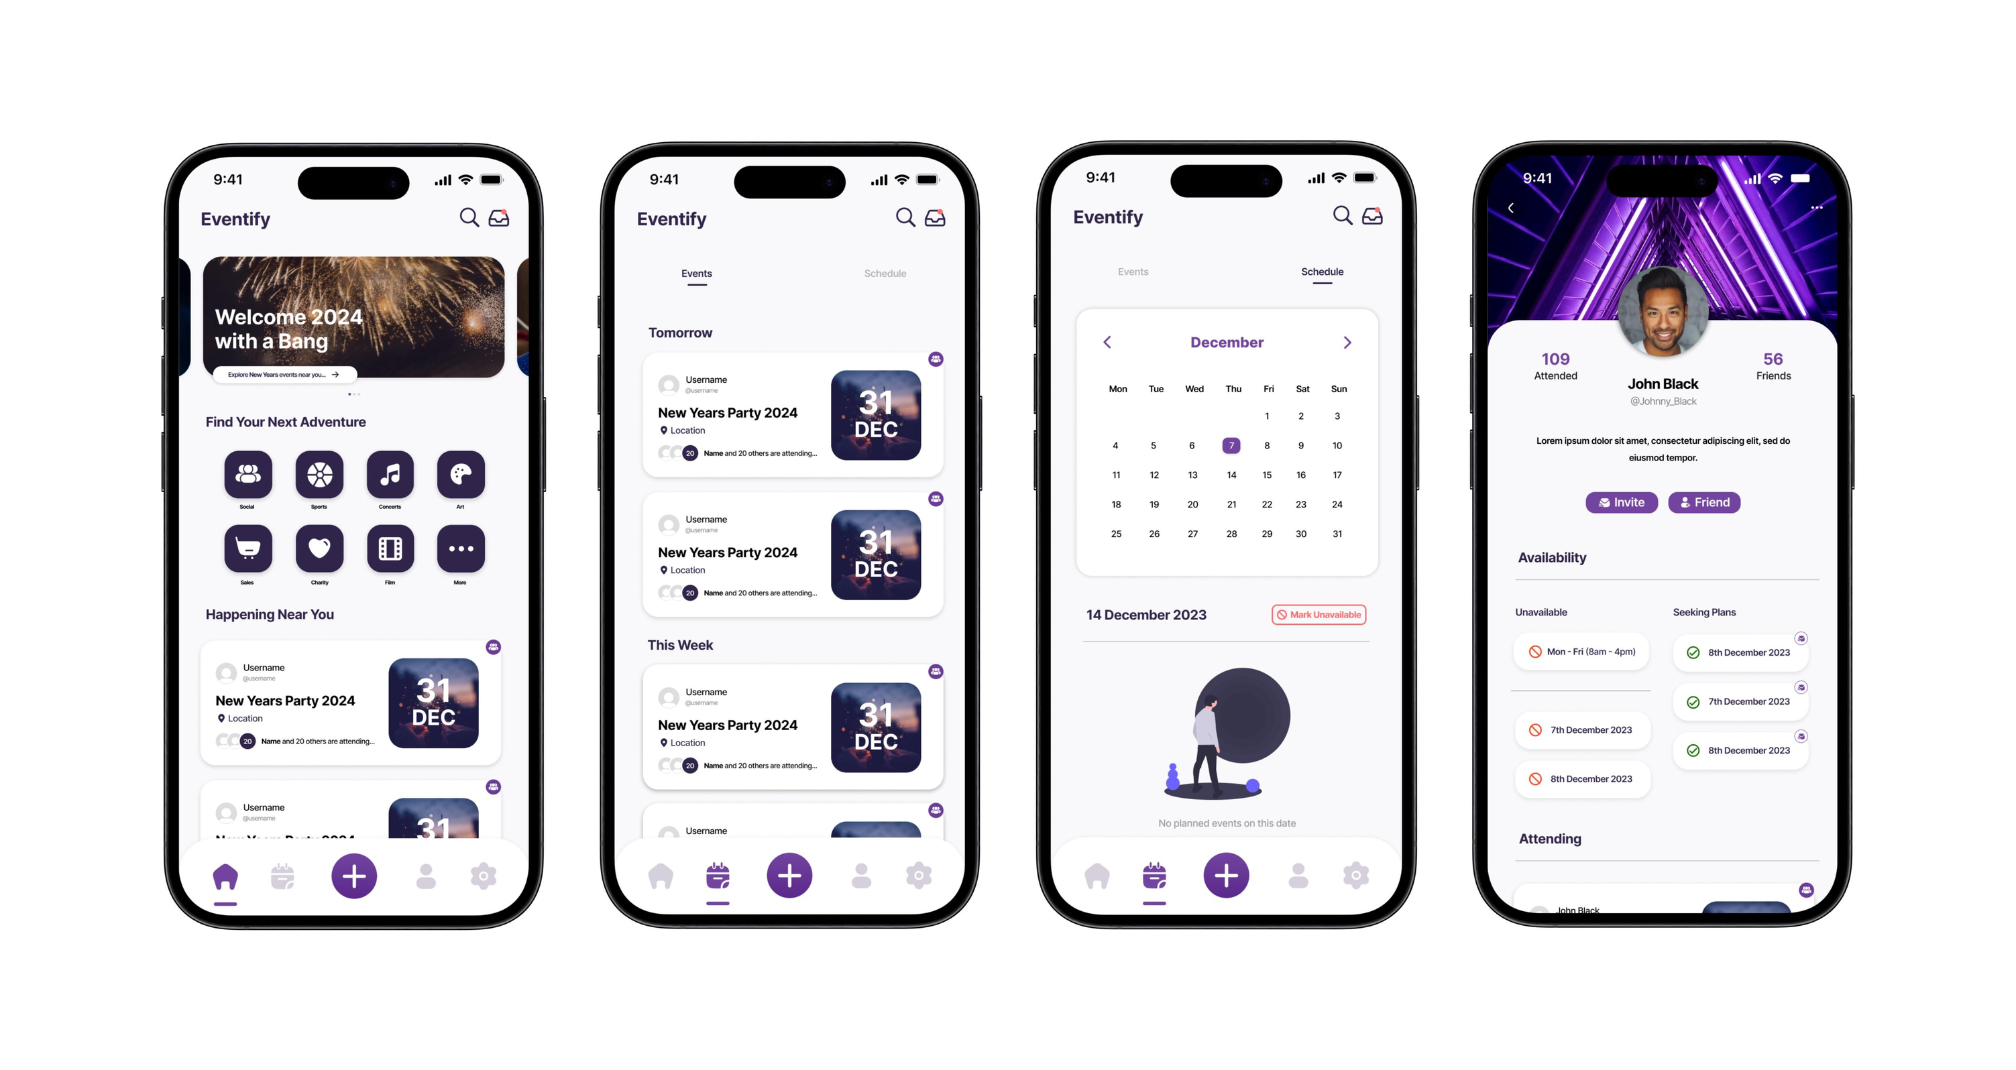
UI Mockups
Eventopia
Eventopia
Eventopia

Slide 10

Innovation
One-stop platform for end-to-end event organizing
and management for organizers and attendees
Real-time Translation & Captioning
- Enabling global accessibility
- Fostering inclusivity in events
Seamless Event Management: Our intuitive platform streamlines event organization, from ticket sales to analytics, freeing organizers to focus on creating remarkable experiences.
Blockchain Ticketing
- Secure and transparent transactions
- Building trust in the industry
Intelligent Virtual Assistants
- AI-powered chatbots for personalized support
- Enhancing attendee experience
Biometric Authentication: Secure biometric authentication
.
Enhanced Engagement Features: Our platform
offers interactive features like live polling, Q&A
and networking opportunities, enabling attendees
to actively engage with event content
, fostering meaningful interactions and leaving a
lasting impression.

Slide 11

AI-based Solutions
- personalized recommendations for attendees
- AI-supported workflows to streamline events end-to-end processes for organizers
01
02
AR/VR Experiences
- Immersive virtual venue tours
- Augmented reality navigation
Metaverse Event Experiences
Exploring virtual event hosting. E.g host Metaverse party/ fashion show for a fashion line launches by big brands who are active in Metaverse like H&M
03
Disruptive
Innovation
03
Sustainability and Carbon Footprint Tracking:
Tools for tracking and offsetting in person events carbon footprints associated with event attendance.
Integration with sustainable transportation and accommodation options.
04
05
Social Media management and analytics
- Integrated all social media accounts for your organization on Eventopia, to have a centralized platform to review notifications, manage profiles, respond, and track engagement supported by AI-generated reports and dashboards
-AI-generated recommendation and strategies for promoting and making events go viral

Slide 12
Value Creation
Organizers
Attendees
Employees
Shareholders
Seamless one-stop platform for end-to-end Event Management
AI powered Automation workflows for creating & managing events.
Data Driven Insights and Analytics
Cutting-Edge Technology Integration
Global expansion
AI based personalized Event Recommendations
Emmersive AR/VR experiences for virtual and navigation
Smart Networking Matches
Interactive Gamification
Mentorship programs
Flexible Work Arrangements
Integrated Wellness resources
Idea Forums and Innovation Challenges
Increased ROI
Global Market Reach
Strategic Partnerships

Slide 13
Stickiness
AI-powered Events & Community Recommendations
Immersive Virtual Experiences
(VR/AR)
Gamified Event Planning &
Participation
AI generated Insights

Slide 14




Market Types
Existing Market
New Market
Exponential Market
Adjacent Market
- We want to be the go-to global events-organizing solution for all events (In-person, Virtual, Hybrid or even in Metaverse)
Metaverse and Immersive Event Experiences: We will support a global audience of bug corporates to host fully immersive, personalized, and gamified events. E.g. Metaverse party/ fashion show for a fashion line launch by big brands who are active in Metaverse like H&M
- Potential Customers: Fashion Brands, Luxury Brands, Tech Giants, Global Business and Corporates Corporates
Real-time Translation and Captioning
For covering Intenational Conferences, Product Launche Events( Apple), etc.
The event organizing and management industry has major players working at different levels: Ticket Master, Eventbrite, Zoom Events, MS Teams
One-stop Solution for Organizers and Attendees: There is a need for a centralized platform that can support audiences: Organizers and Attendee for end-to-end event management and attendance
Smarter, Faster, and Better Services: Our solution is adaptive and supported by the latest technology to provide the best experience to customers (Event organizers and attendees ) at global level
Artificial Intelligence (AI) and Machine Learning (ML) based solutions: enhance event experiences through personalized support, optimized content curation, and tailored recommendations. Improving attendee engagement his will drive attendee engagement and loyalty, enabling premium pricing models
Sustainability and Carbon Footprint Tracking: Encourage environmentally responsible events, Eventopia's sustainability tracking solutions will attract eco-conscious organizers and attendees.
Augmented Reality Enhanced Presentations and Exhibits (USP)
Eventopia's innovative AR capabilities will revolutionize event presentations and exhibits, providing immersive and engaging experiences for attendees. The uniqueness of this offering will attract event organizers and exhibitors, driving adoption and recurring revenue.
Hotel and Accommodation Industry
- Partnering with hotels and accommodation providers to offer integrated lodging solutions, generating revenue through 10% on commissions, and creating cross-selling opportunities with tailored accommodation packages based on event data and attendee preferences.
Travel and Tourism Industry
- Collaborating with travel agencies, airlines, and tourism boards to create comprehensive event travel packages, unlocking additional revenue streams through commissions, and targeted advertising opportunities based on event and attendee data.

Slide 15



Marketing Strategy
Precise Audience Targeting
Targeting audience based on their interest and suggesting Events & Communities accordingly
PR Strategy
Simplify product launch events
Maximize ROI
Cost-effective solution
Marketing Channels
Content Marketing:
Social Media Marketing
Paid Advertising
Webinars & Online Events

Slide 16



Marketing Strategy
Metrics & Tracking
Monitor results, Report insights & provide best practices
Partnerships
Co-working Spaces & Event Venues
Marketing & PR Agencies (Globalization )
Industry Influencers
Branding & Support
Build a Strong Brand Identity
Offer Excellent Customer Support
Showcase Customer Success Stories

Slide 17
Business Model
For Organizers
Subscription Based
Free Trial
Starter
Pro
Premium
For organizers who are just
getting started
$0
Host your event for free*
For organizers hosting small events
$29 /month
For organizers hosting medium sized
events
$ 69/month
For organizers hosting large events
$ 139/month
100 attendees/event
Unlimited events
Session duration- up to 6 hours per event
Access to event planning, marketing/ designing and ticketing features
Budgeting and expense tracking tools
Event optimization through AI
Access to Gamification tools
Everything in Pro, plus:
1000 attendees/event
No session duration limit per event
Access to AR and VR features
Access to Live translation and transcription services in
multiple languages
Access to attendee management tool
25 attendees/ event
Host 3 free events
Session duration- up to 45 minutes per event
Send up to 150 marketing emails a day
Access to event planning, marketing/designing and ticketing tools
Everything in starter, plus:
500 attendees/event
Session duration- up to 8
hours per event
Access to AI task automation tools
Access to Live translation and transcription services only in 2 languages

Slide 18
Business Model
For Organizers
Pay per Event Based
Free Trial
Starter
Pro
Premium
Premium
For organizers who are just
getting started
$0
Host your event for free*
For organizers hosting small events
$49/event
For organizers hosting medium sized
events
$ 99/event
For organizers hosting large events
$ 159/event
100 attendees/event
Session duration- up to 6 hours per event
Access to event planning, marketing/ designing and ticketing features
Budgeting and expense tracking tools
Event optimization through AI
Access to Gamification tools
Everything in starter, plus:
500 attendees/event
Session duration- up to 8
hours per event
Access to AI task automation
tools
Access to Live translation and
transcription services only in
2 languages
Everything in Pro, plus:
1000 attendees/event
No session duration limit per event
Access to AR and VR features
Access to Live translation and transcription services in
multiple languages
Access to attendee management tool
25 attendees/ event
Host 3 free events
Session duration- up to 45 minutes per event
Send up to 150 marketing emails a day
Access to event planning, marketing/designing and ticketing tools

Slide 19
Business Model
For Attendees
Freemium
Premium
$0
$10/month
Adjacent Market
Accomodation/ Venue industry | 10% commision per booking
Travelling industry (Airlines) | 10% commision per booking
Everything in Freemium, plus:
Receive unlimited personalized event recommendations through AI
Social & Networking Recommendations using AI
Priority based engagement
On-demand access to recorded sessions
Receive 3 personalized event recommendations through AI
Participate through Gamification tools
All attendees need to buy tickets despite being a Freemium or Premium members

Slide 20
Sales Strategy- Assumptions
There are approximately 3.2 million small and medium-sized businesses (SMBs) operating in the United States. (This focuses on the potential of the market)
Assuming 3.2M SMBs in our target market and a 2% conversion rate, we get a potential user base of:
Quarter | Estimated No of Users
Q4 | 10000
Q5 | 18000
Q6 | 28000
Q7 | 42000
Q8 | 65000

Slide 21
Cost Assumptions
Out Source resources from India
Size of Development Team (hourly $22): 6
Size of Testing Team (hourly $15): 3
No. UI/UX Designers (hourly $15): 2
Size of Legal Compliance Team (hourly $20): 2
Size of AI/ML Team (hourly $25): 2
Global Expansion
Global target countries - Small business leading countries
North America (United States, Canada, and Mexico)
Europe (Germany, UK, France, Italy) Asia-Pacific (China, Japan, Korea, India, Australia, Indonesia)
South America (Brazil, Argentina)

Slide 22
Sales Cost
Year | Q1 | Q2 | Q3 | Q4 | Q5
Operations Cost Software Developers (7*22*500) UI/UX development (2*15*500) AI/ML Engineers (3*25*500) Testing Team (3*15*500) | $343,000 | $360,000 | $410,000 | $618,500 | $660,000
Development Software & Licensing Partnership initiatives Globalization Legal Compliance Cost | $110,000 | $130,000 | $180,000 | $150,000 | $240,000
Marketing Digital Advertising Influencer Marketing | $10,000 | $20,000 | $50,000 | $60,000 | $70,000
Total | $463,000 | $510,000 | $640,000 | $828,500 | $990,000

Slide 23
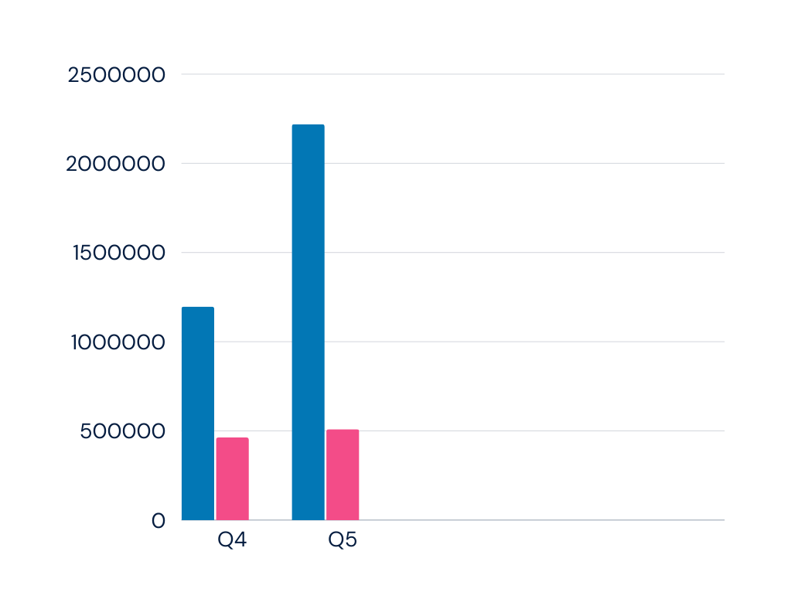
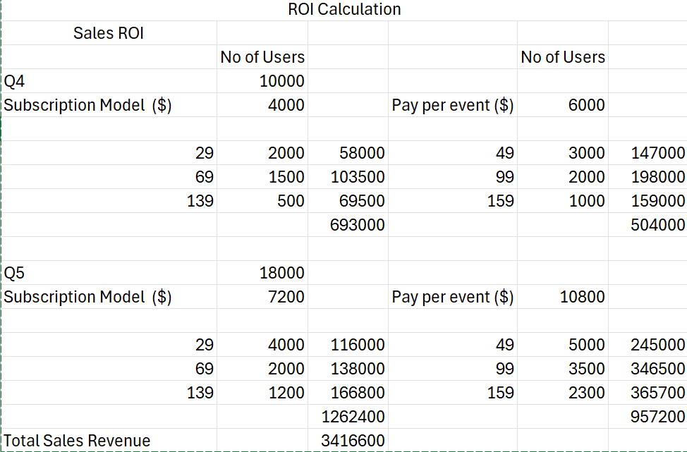
Sales ROI
For ROI Calculation we have consider 40% customers use subscription model and 60% customers use pay per event model.
> Investment for Q1 to Q3 - $ 1,613,000
> Total Sales Cost (Q4 to Q5)- $ 1,818,500
Revenue
Cost

Slide 24
After Market Cost
Year | Q6 | Q7 | Q8
Operations Cost Software Developers (7*22*500) UI/UX development (2*15*500) AI/ML Engineers (3*25*500) Testing Team (3*15*500) | $520,000 | $ 510,000 | $ 390,000
Development software & Licensing partnership initiatives for adjacent market Legal Compliance cost | $310,000 | $ 240,000 | $ 180,000
Marketing Digital Advertising Community Engagement Public Relations | $150,000 | $ 110,000 | $ 90,000
Total | $980,000 | $ 860,000 | $ 680,500

Slide 25
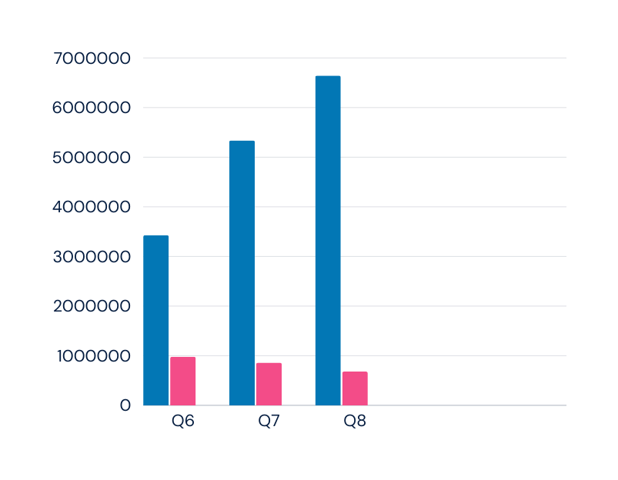
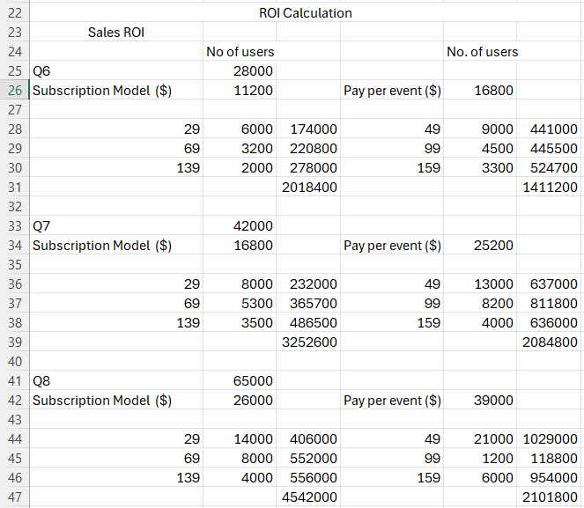
After Market ROI
Total Aftermarket Cost for Q6 to Q8 - $ 2,520,000
After Market ROI = Total revenue - investment/ investment
= $ 30,328,300 - 2,520,000 / 2,520,000
= 11%
Revenue
Cost

Slide 26
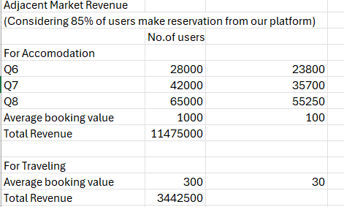
After Market ROI

Slide 27
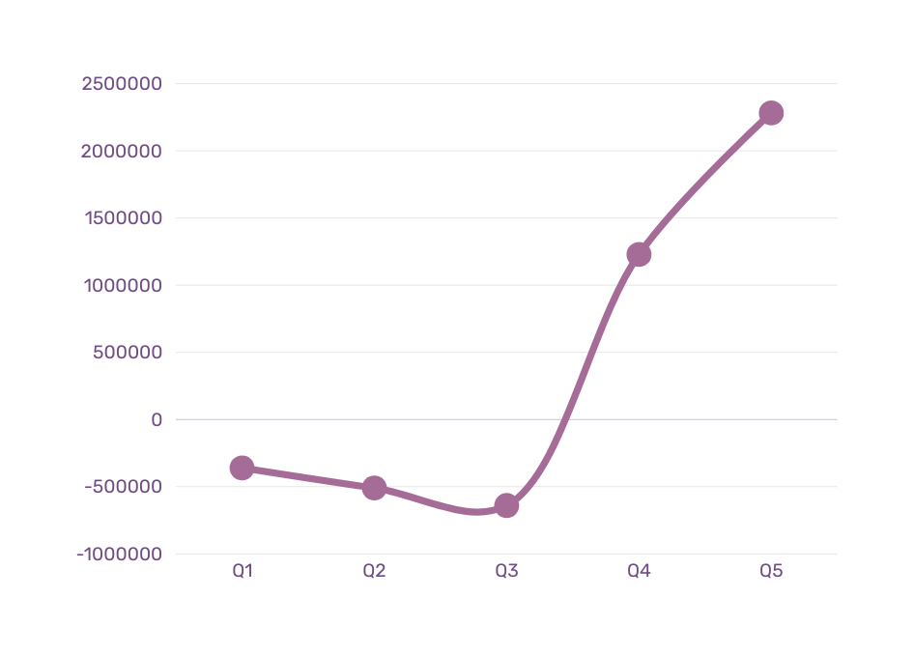
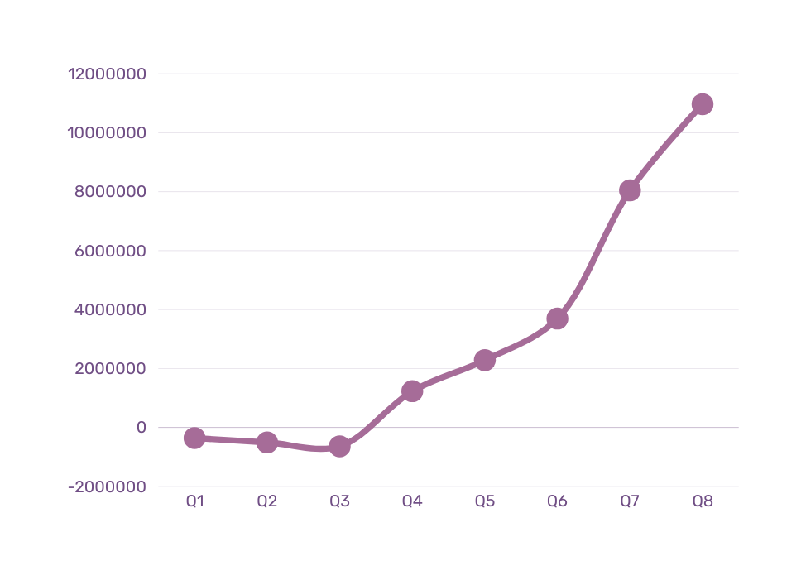
J-Curve
Sales J Curve
Aftermarket J Curve
Profits after aftermarket strategy grew by 4.6X
Revenue grew by 2.1x times

Slide 28

Presented by Group-10
THANK YOU!

